Slide 1

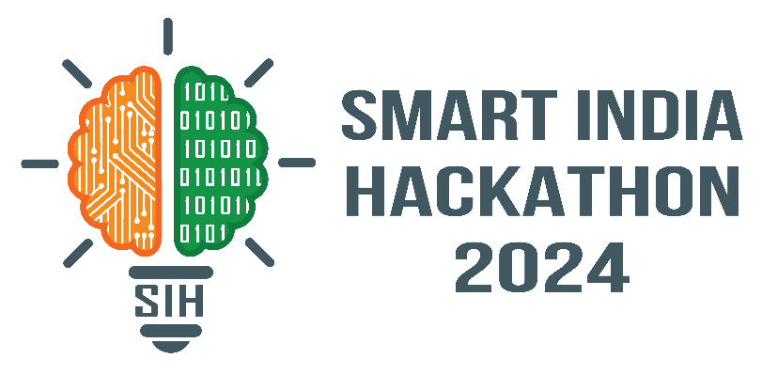
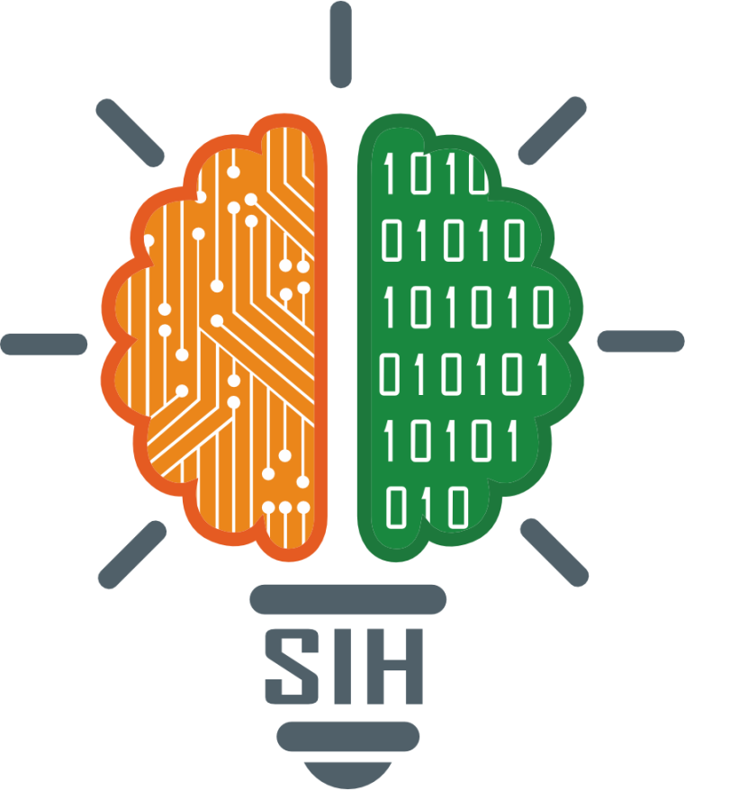
SMART INDIA HACKATHON 2024
TITLE PAGE
Problem Statement ID – 1555
Problem Statement Title- Virtual Herbal Garden: Discover AYUSH Medicinal Plants
Theme- MedTech / BioTech / HealthTech
PS Category- Software
Team ID- 28330
Team Name : Griffyndor

Slide 2

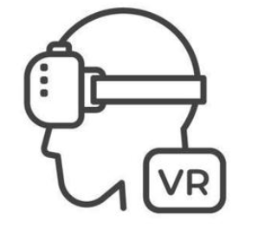

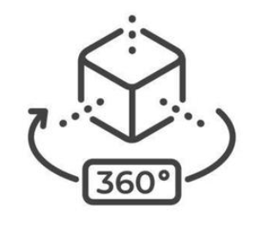
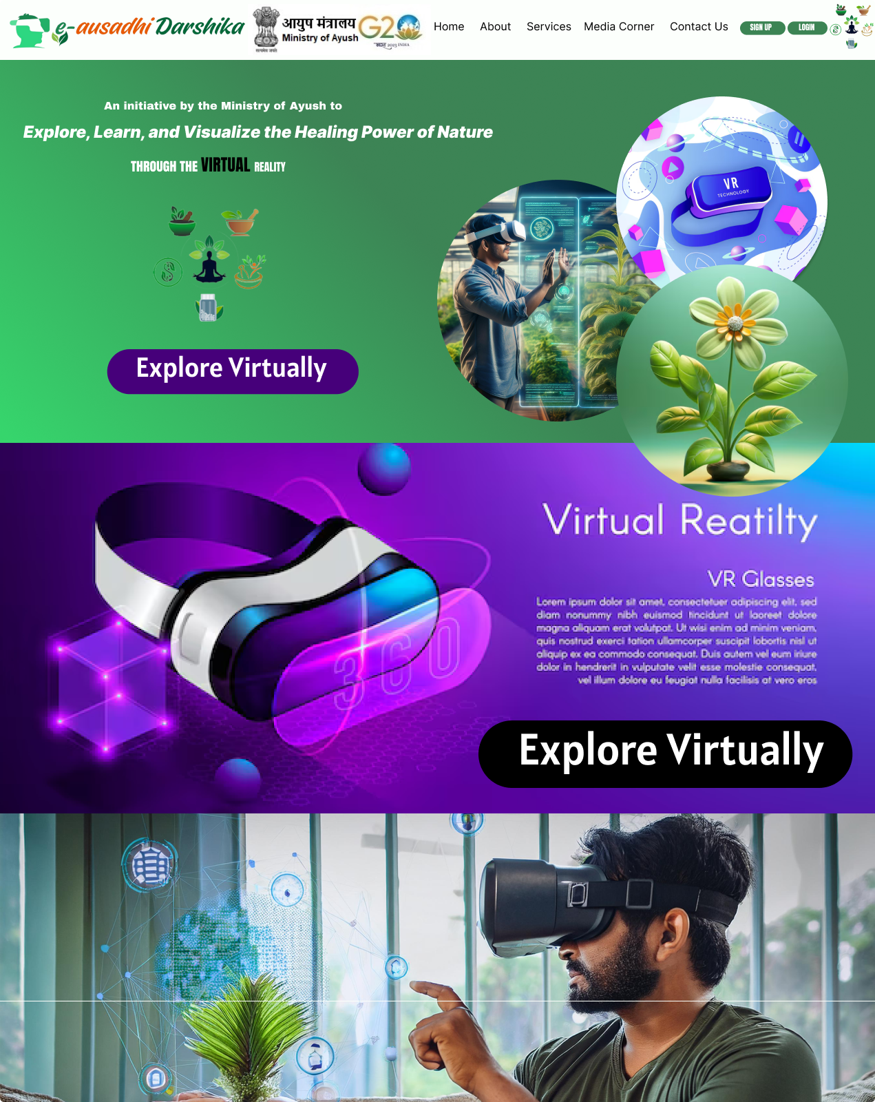
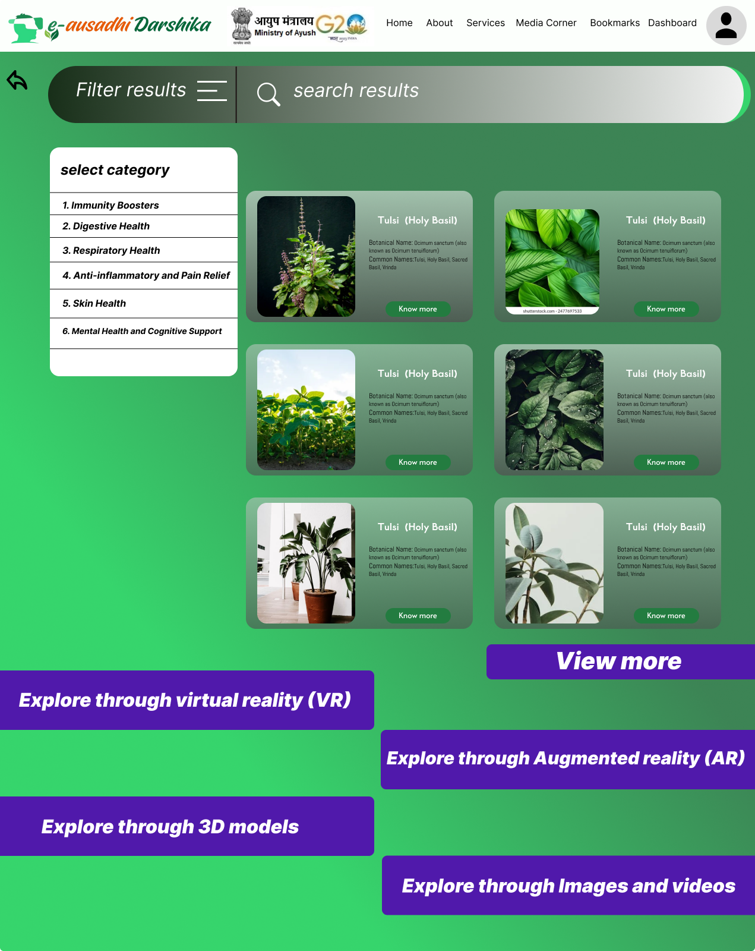
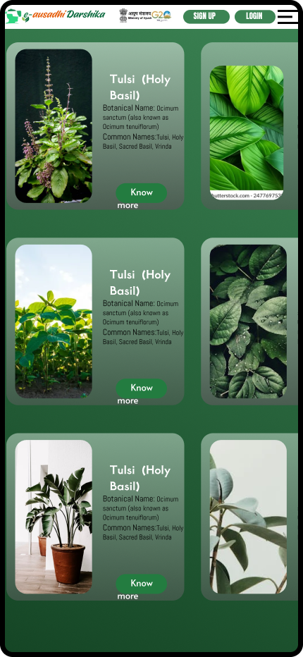
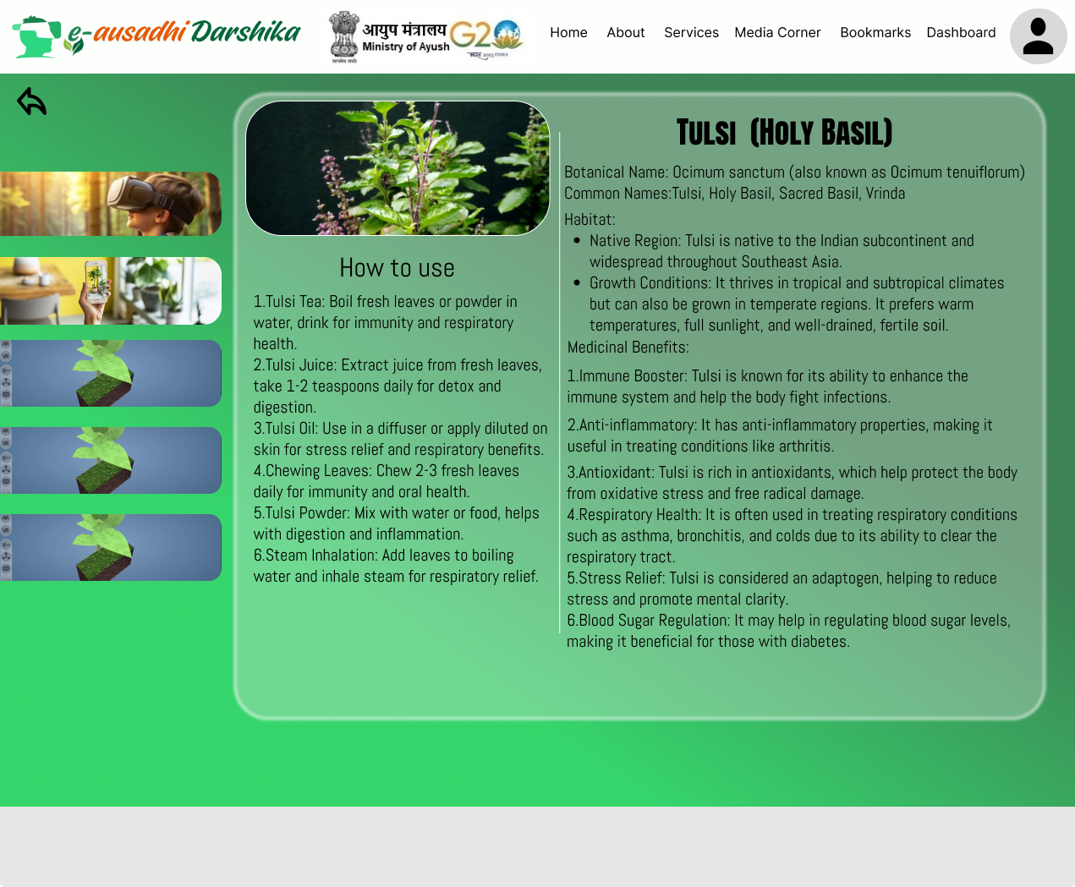
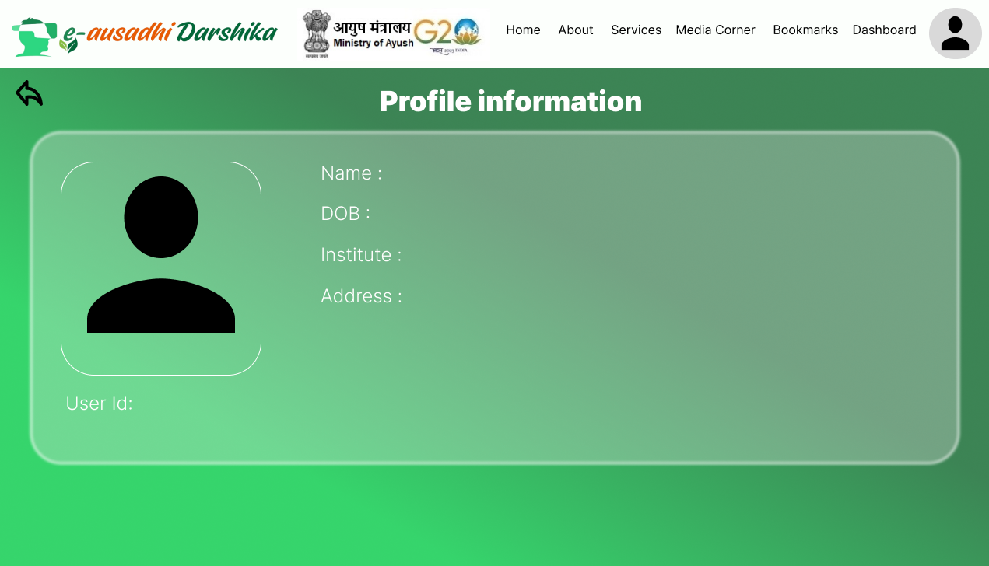
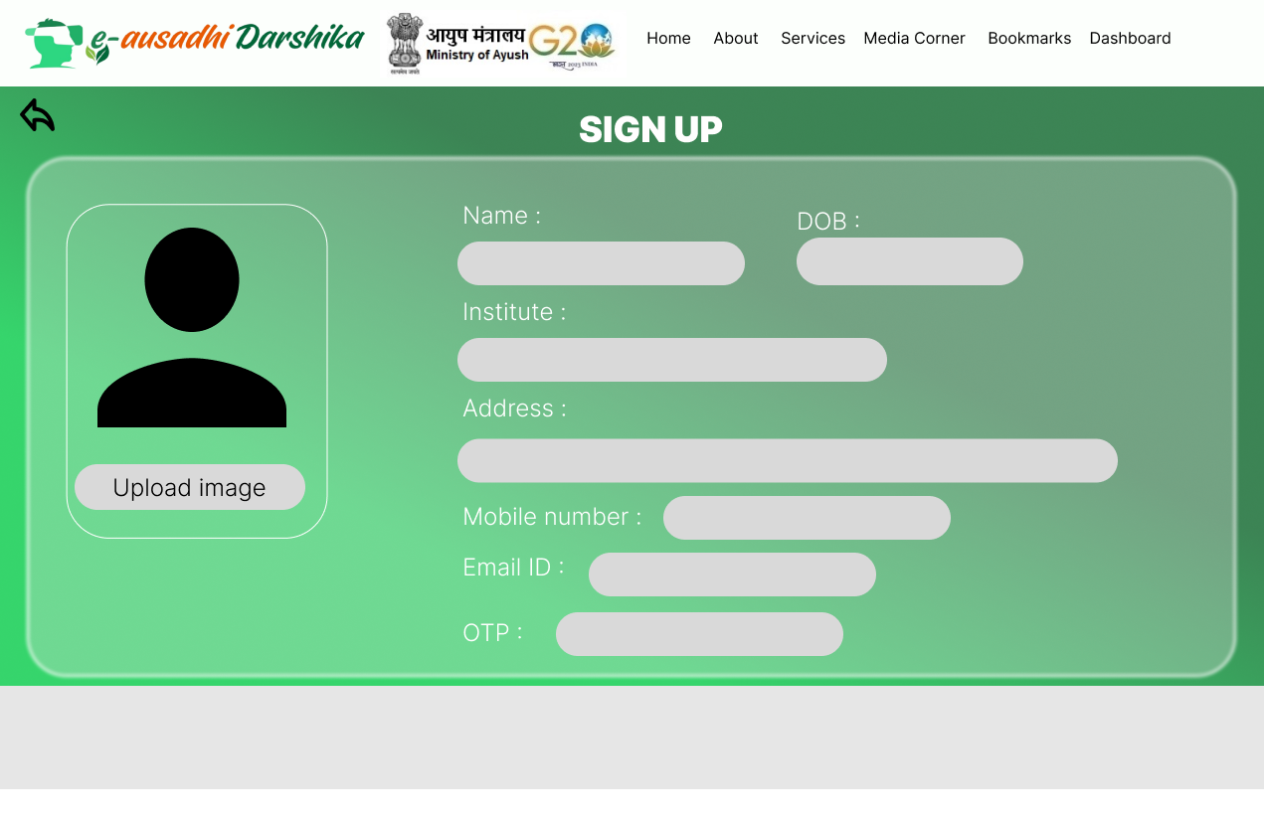
GrIffYndor
Proposed Solution:
Detailed explanation of the proposed solution: A Virtual Tour to the Herbal Garden that provides users with an interactive, educational experience of medicinal plants used in the AYUSH department.
How it addresses the problem:
Accessibility: Traditional herbal gardens are not easily accessible to everyone due to location or physical limitations. But e-ausadhiDarshika comes with totally different approach and removes these limitations by providing broad spectrum of learning methodologies.
Educational Value: A rich educational experience for students, practitioners, and enthusiasts that poses for a attractive way of learning through graphics and 3D models.
Engagement: Engage directly with the plants, which enhances learning and retention through VR experiences.
Innovation and Uniqueness of the Solution:
Immersive Experience at your comfort via non-traditional ways of learning.
Customizable Learning Paths: Allows users to tailor their learning journey based on their interests in
Virtual Reality (VR)
3D Models
Augmented Reality (AR)
Audio description
High quality Images/Videos
Features :
Filter based on categories & Bookmark
Text and Image search & Social Media Sharing
AI chatbot for assistance
User Interface
2

Slide 3
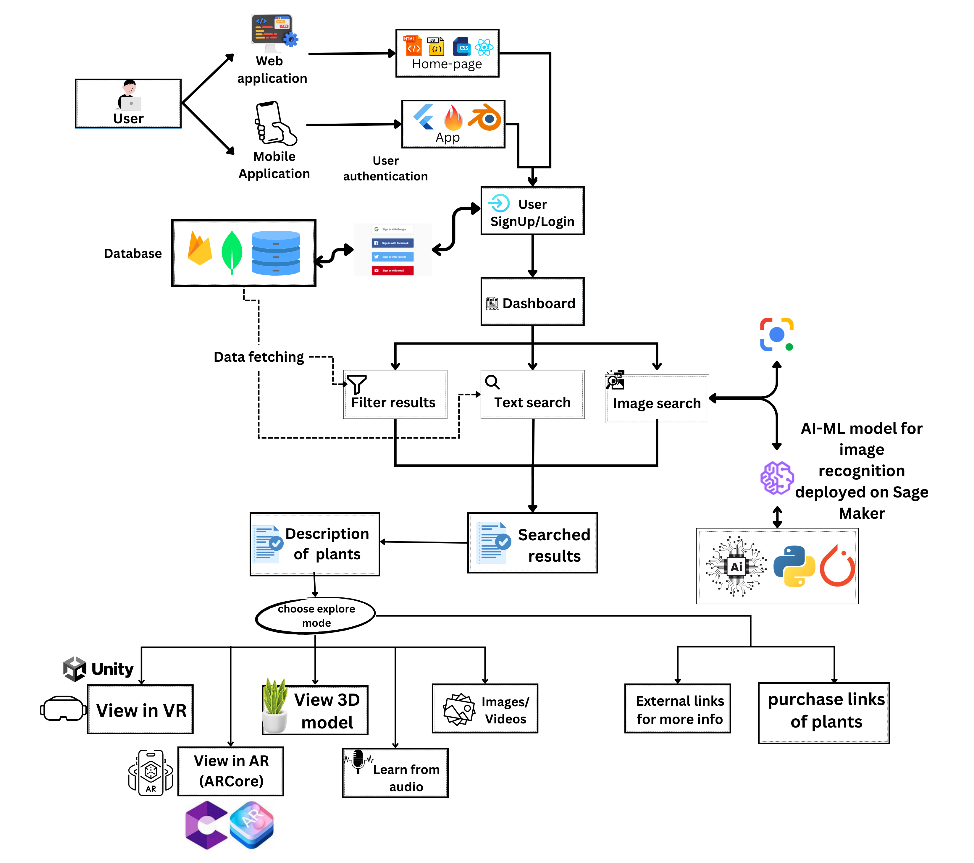
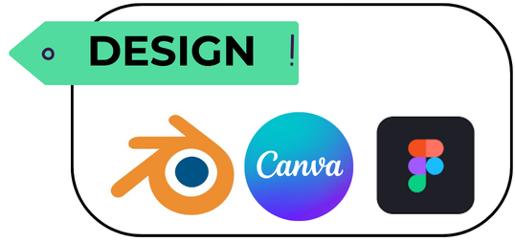
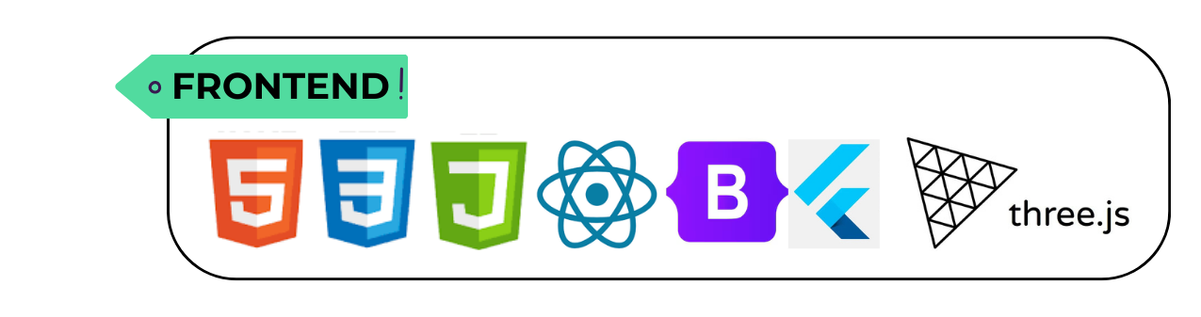
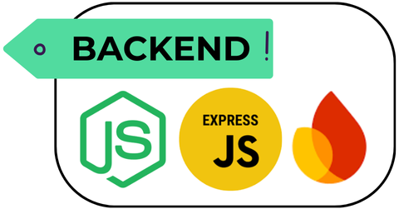
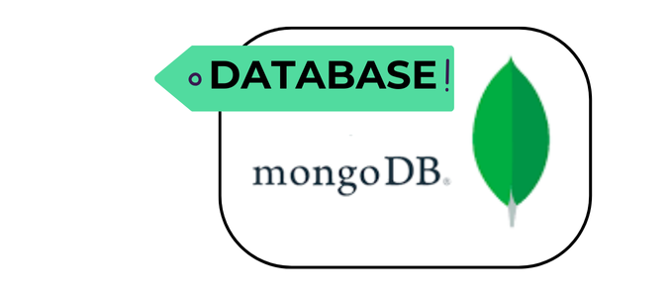

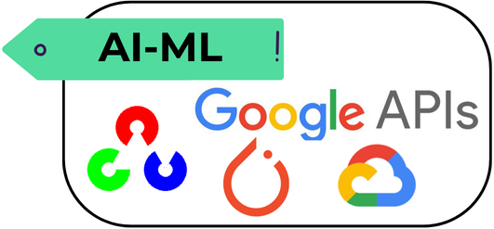

TECHNICAL APPROACH
GrIffYndor
GrIffYndor
Technologies to be used (e.g. programming languages, frameworks, hardware)
a. Programming Languages – HTML,CSS, JS, Python, Dart, C#
b. Frontend – React, Bootstrap, Tailwind, Three.js
c. Backend – Node, ExpressJS, Docker
d. Database – MongoDB, Firebase, GCP
e. VR – Unity, Blender, Oculus
f. AI-ML – PyTorch,OpenCV,Pandas,Numpy,Scikit-Learn,SageMaker
g. Web Hosting – Vercel, GitHub
h. Mobile Application – Flutter
Flow-Diagram of Working Prototype

Slide 4
FEASIBILITY AND VIABILITY
GrIffYndor
Griffyndor
Gryffindor
Analysis of the feasibility of the idea :
Technical Feasibility: Whether the technology needed is available and whether the project can be built with current technological resources.
Economic Feasibility: Evaluate the financial aspects, including initial ongoing expenses, and potential revenue.
Operational Feasibility: Analyze if the organization has the resources and capability to implement and maintain the project.
Legal and Regulatory Feasibility: Ensure the project complies with relevant laws, regulations, and standards.
Potential challenges and risks:
Technical Challenges: Identify potential technical hurdles such as integration issues, technology limitations.
Financial Risks: Address the risk of budget overruns, funding shortages, or financial mismanagement.
Operational Risks: Consider issues related to resource allocation, staff turnover, or operational inefficiencies.
Market Risks: Evaluate the risk of market changes, competition, or shifts in customer preferences that could impact the project’s success.
Regulatory Risks: Discuss potential legal challenges, compliance issues, or changes in regulations that could affect the project.
Benefits of the solution (social, economic, environmental, etc.) Strategies for overcoming these challenges
Technical Solutions: Implement robust testing and quality assurance processes. Invest in scalable technology and consider alternative technical solutions if necessary.
Financial Management: Seek additional funding sources if needed and maintain financial oversight.
Operational Planning: Create a comprehensive project plan with clear milestones. Ensure adequate training and support for the team.
Market Analysis: Conduct thorough market research to stay ahead of trends and competitors.
Legal Compliance: Engage with legal experts to ensure compliance with all regulations.

Slide 5
IMPACT AND BENEFITS
Griffyndor
GrIffYndor
Gryffindor
Potential impact on the target audience :
1. Target Audience Identification: Clearly define who the primary and secondary target audiences are. Consider their demographics, needs, and how they interact with the solution.
2. Impact on Users: Discuss how the solution will directly affect the lives of users. This could include improved quality of life, enhanced productivity.
3. Feedback and Adoption: Address how feedback from target audiences will be collected and how it will influence the implementation.
4. Long-Term Impact: Consider the long-term effects on the target audience, such as changes in behavior, attitudes, or lifestyle.
Benefits of the Solution
1. Social Benefits: Explain how the solution will contribute to the community or society. This could include improved social interactions, enhanced access to services, or positive effects on social well-being.
2. Economic Benefits: Outline the economic advantages, such as cost savings, revenue generation, job creation, or increased economic activity. Consider both direct and indirect economic impacts.
3. Environmental Benefits: Detail any positive environmental impacts, such as reduced resource consumption, decreased waste, or improved sustainability practices. If applicable, mention any certifications or standards the solution adheres to.
4. Other Benefits: Highlight any additional benefits that do not fall into the above categories, such as technological advancements, innovation, or contributions to knowledge.

Slide 6
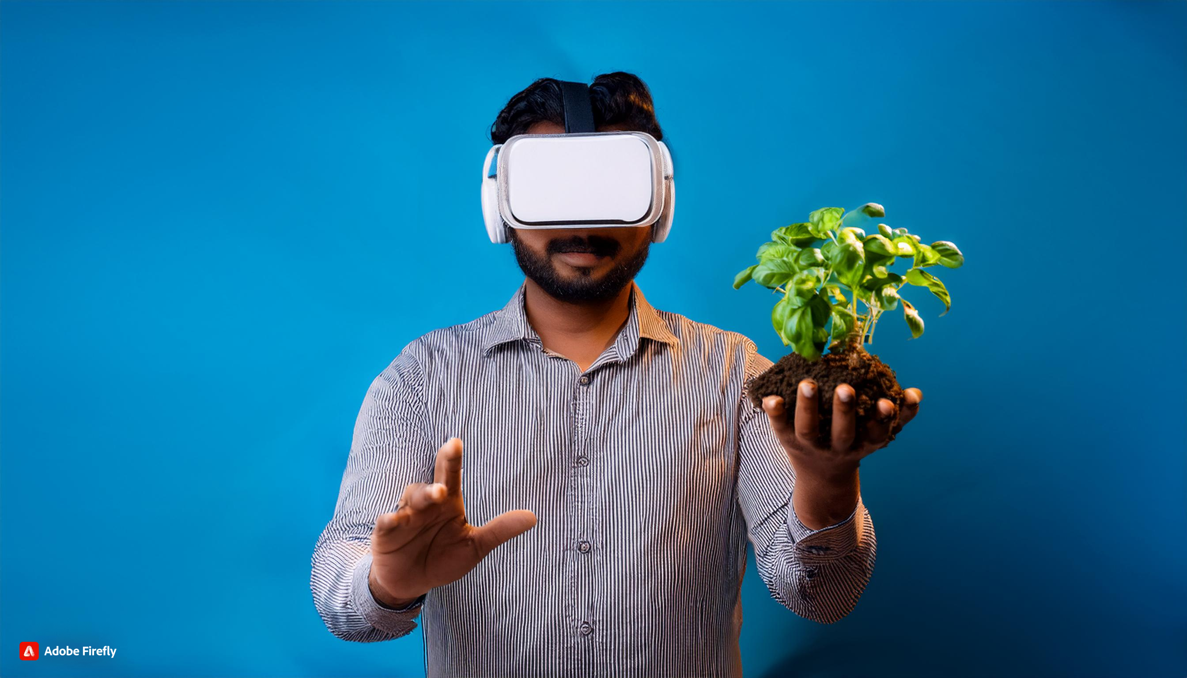
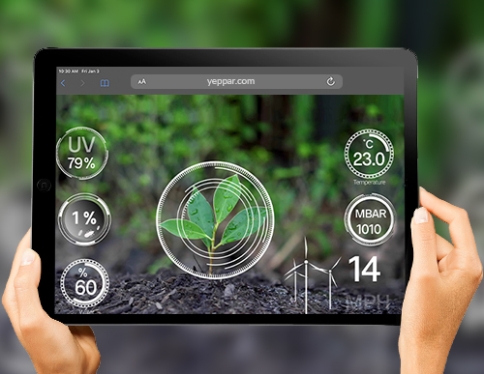
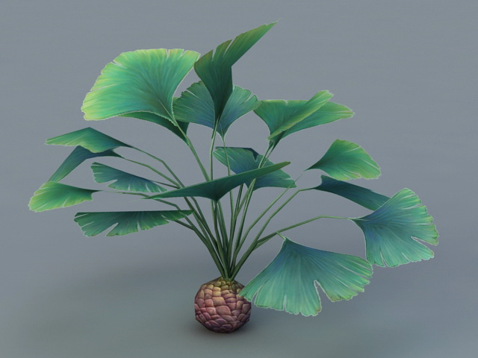


RESEARCH AND REFERENCES
Griffyndor
GrIffYndor
Gryffindor
Video for Demonstration :
1. https://drive.google.com/drive/folders/1amD_IMZoOznnxJ0uj6pv-NGxFsNe2baD?usp=sharing*
2. https://www.youtube.com/watch?v=FDE1CwYFCrM
Virtual Reality (VR) immerses users in simulated environments, enhancing experiences . Research shows VR improves learning retention, therapeutic outcomes, and real-world skill application.
Demo Project (GitHub Link) :
1. https://github.com/ayushrskiaa/SIH-project-2024
2. https://github.com/ayushrskiaa/SIH-project-docs
Augmented Reality (AR) overlays digital content onto the real world and enhance user interactions. Research indicates AR improves task performance and learning engagement.
Research on various Herbal Plants :
Link : https://drive.google.com/drive/folders/1amD_IMZoOznnxJ0uj6pv-NGxFsNe2baD?usp=sharing*
Research & Refferences :
1. Wikipedia : https://en.wikipedia.org/wiki/Medicinal_plants
2. Dabur : https://shorturl.at/M9Dc4
3. Medicine Library : https://www.ncbi.nlm.nih.gov/books/NBK92773/
4. HerbMed : https://www.herbday.org/gallery/
5. Herbal Academy : https://theherbalacademy.com/
6. NCCIH : https://www.nccih.nih.gov/health/herbs
3D models of plants offer detailed visualization for scientific research, enhancing botanical studies. Research shows these models aid in plant morphology analysis and accurate simulations of ecological environments.

